Slide 1

Computational Imaging Project – Final Presentation
Dhruv Sharma
ID - aw51ylaq

Slide 2
Dataset

Slide 3
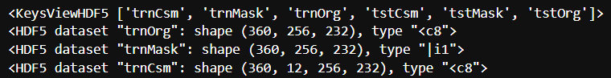
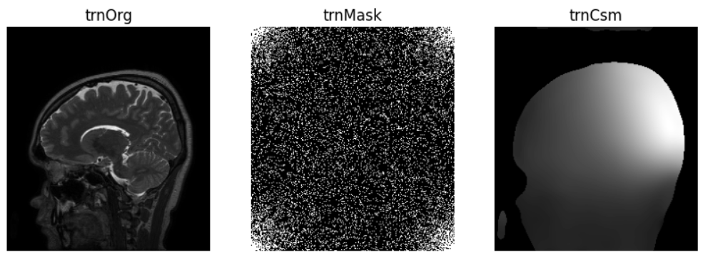
Default Dataset
*trnMask is shifted

Slide 4
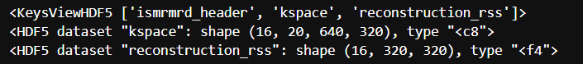
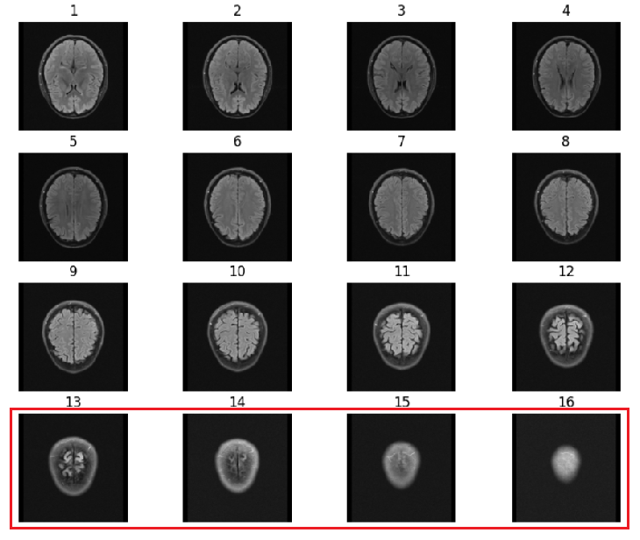
FastMRI Dataset
Reconstructions from fastMRI kspace using sigpy
Last slices does not contribute much information.

Slide 5
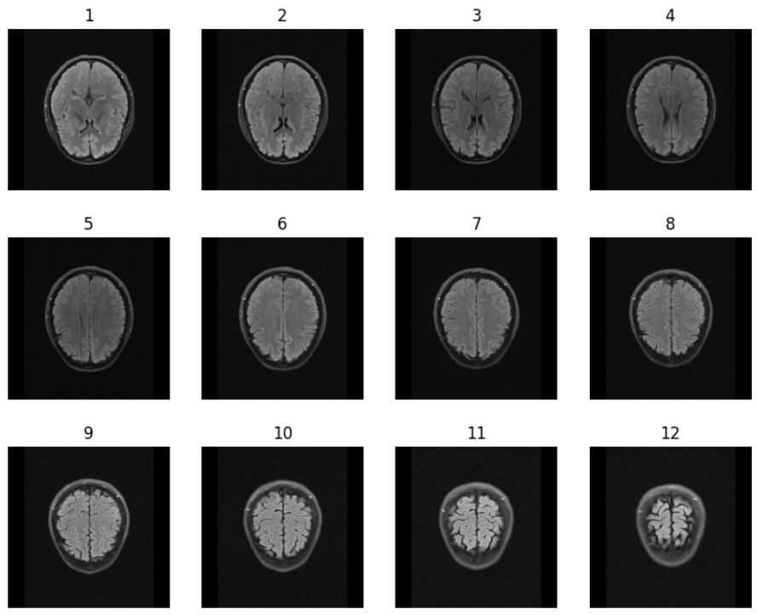
After removing end slices

Slide 6
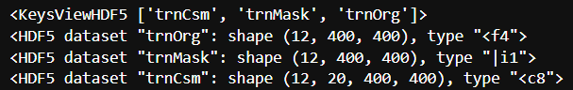
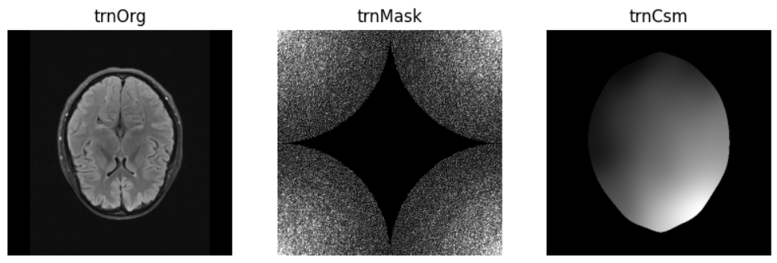
FastMRI converted to proper format
Mask is 4x accel. Dataset contains slices from all contrasts
[AXFLAIR, AXT1POST, AXT1PRE, AXT1, AXT2]

Slide 7
MoDL and VarNet

Slide 8
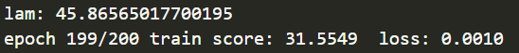
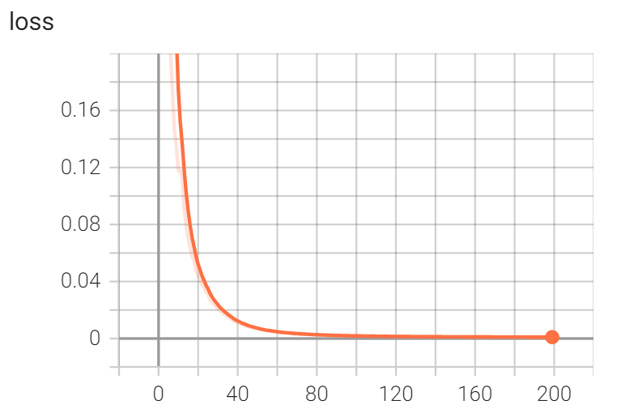
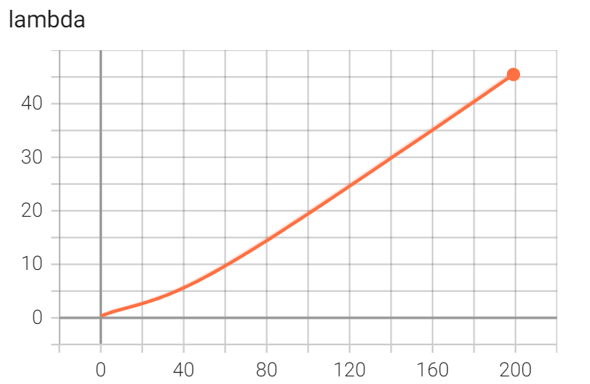
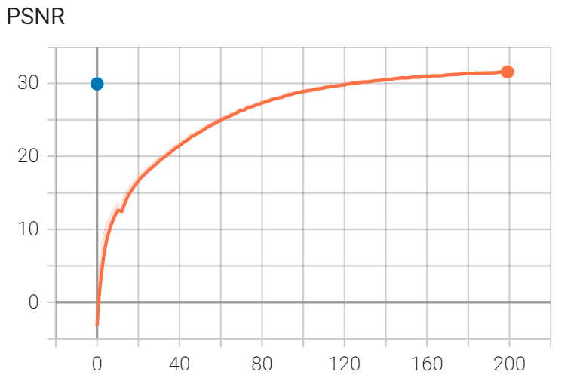
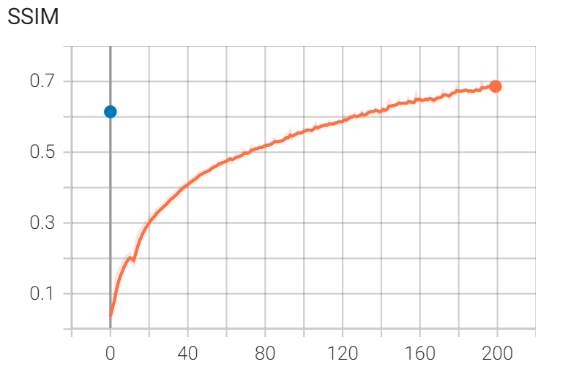
MoDL Training on Default Dataset
n_layers: 5
k_iters: 10
epochs: 200

Slide 9
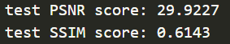
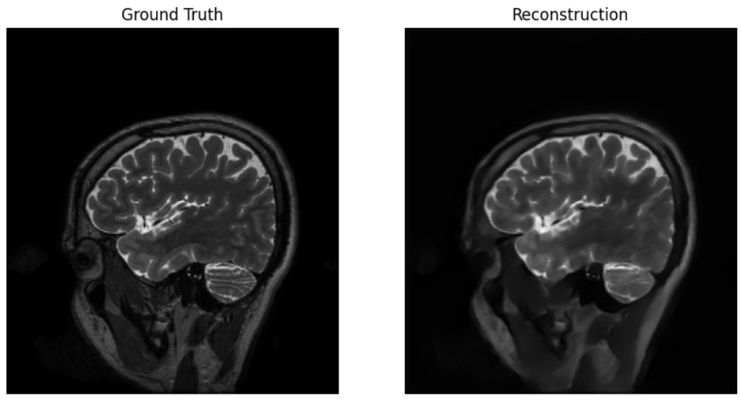
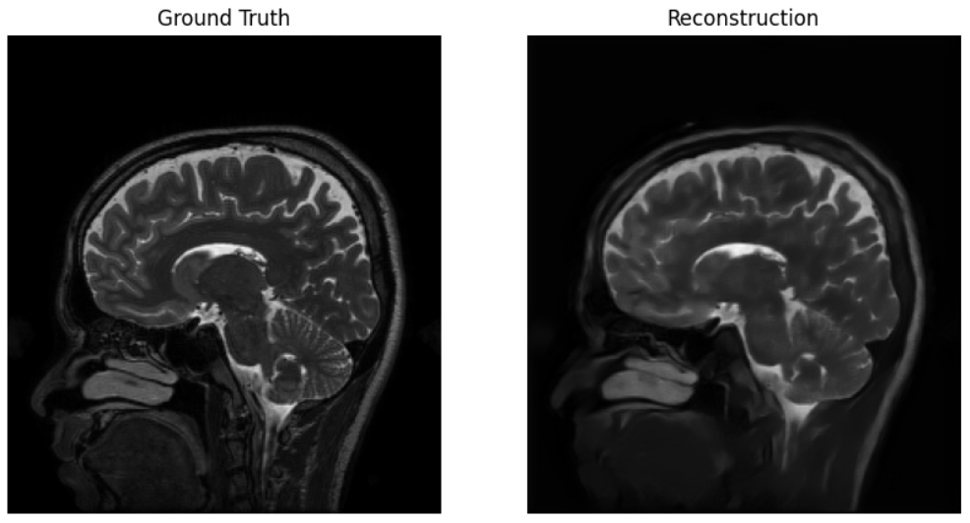

Slide 10
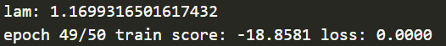
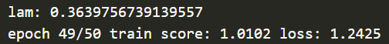
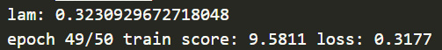
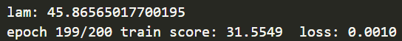
Effect of Normalization on Train Score
No normalization
Normalized to -1 and 1
Normalized to 0 and 1
Normalized to 0 and 50

Slide 11
VarNet – Unet Weights

Slide 12
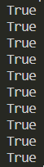
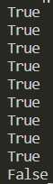
VarNet – Weights Update Problem
Check if weights of unets inside unets_list are updating correctly.
initial_unet_states == current_unet_states ??
Output for n_cascades = 10
Only the weights of the last Unet are updated.
Before forward pass and gradient descent step
After forward pass and gradient descent step

Slide 13
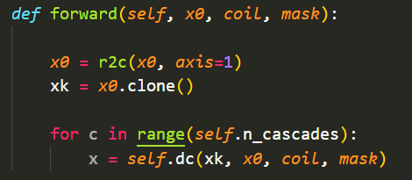
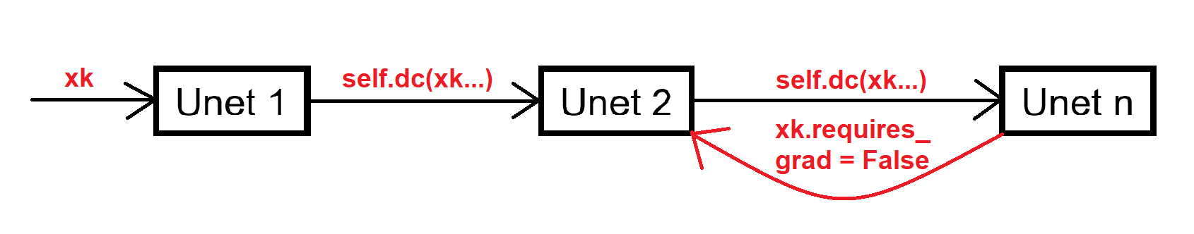
Cause
The backpropagation chain is broken at each unet step because xk.requires_grad = False. Therefore, only the last unet gets updated.

Slide 14
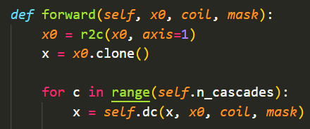
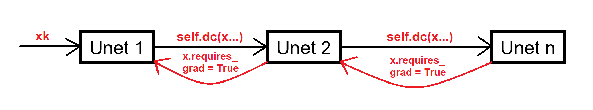
Solution
The backpropagation chain is not broken at each unet step because x.requires_grad = True. Therefore,all unets are updated.

Slide 15
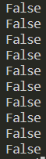
After Correction
Check if weights of unets inside unets_list are updating correctly.
initial_unet_states == current_unet_states ??
Output for n_cascades = 10
Weights for every unet are updated correctly.
Before forward pass and gradient descent step
After forward pass and gradient descent step

Slide 16
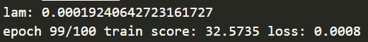
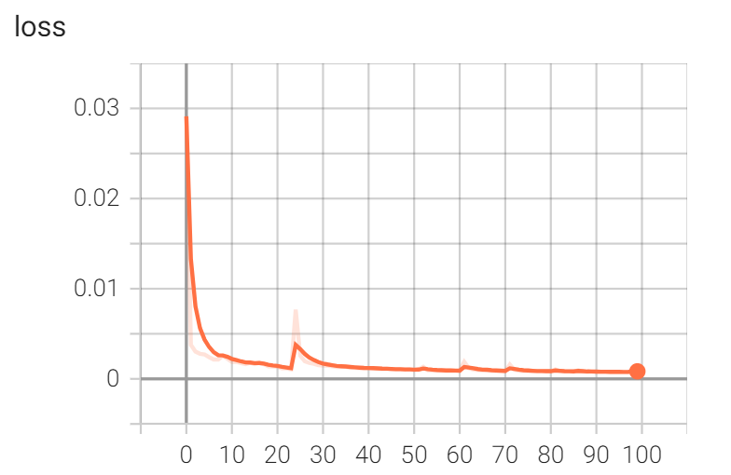
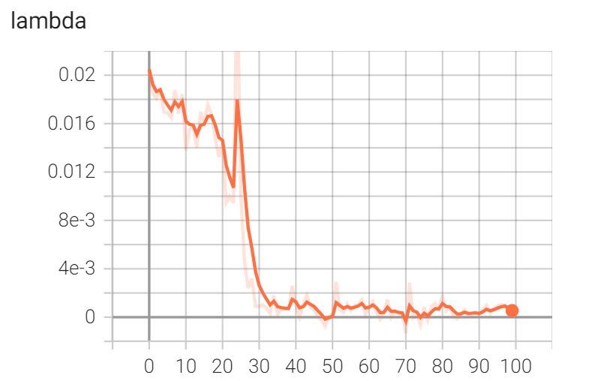
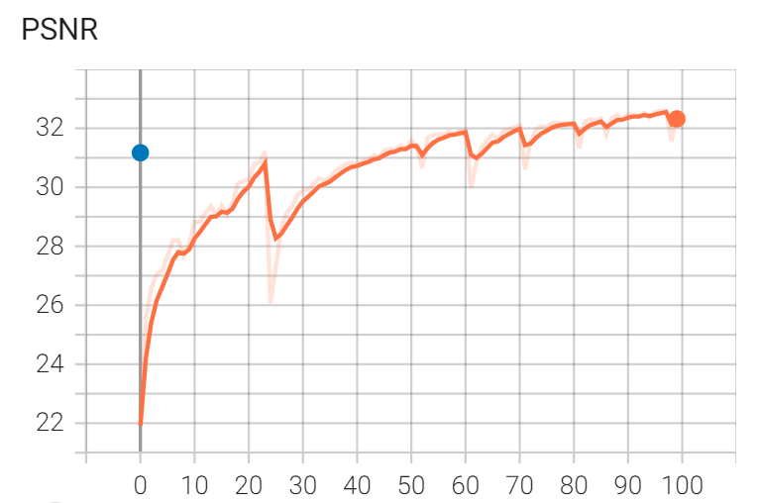
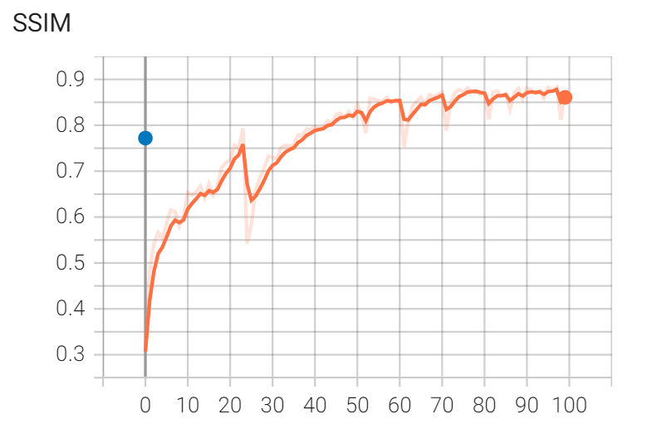
VarNet Training on Default Dataset
n_layers: 5
k_iters: 10
epochs: 100

Slide 17
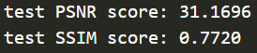
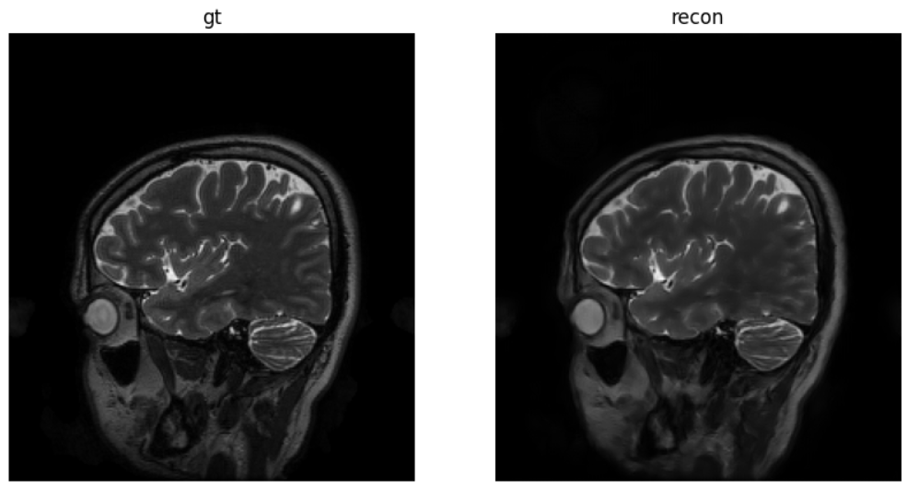
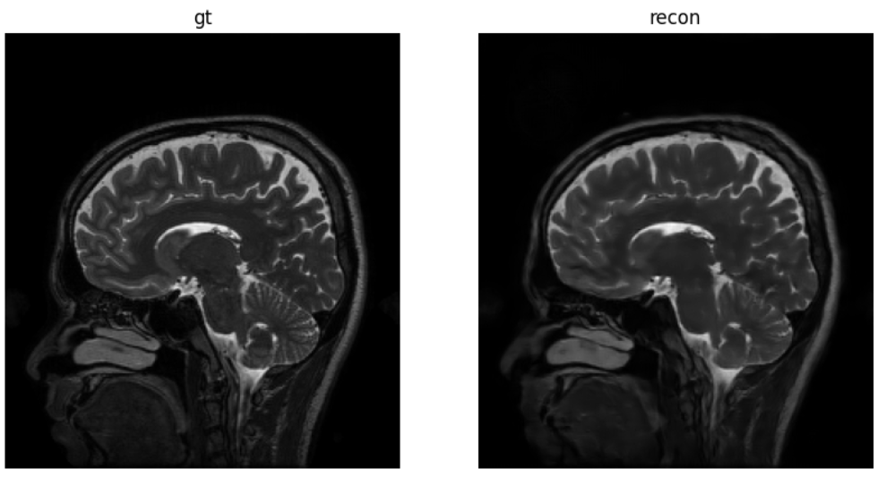

Slide 18
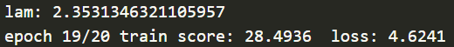
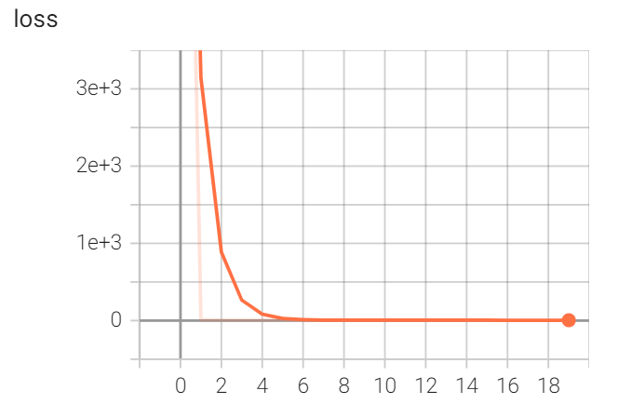
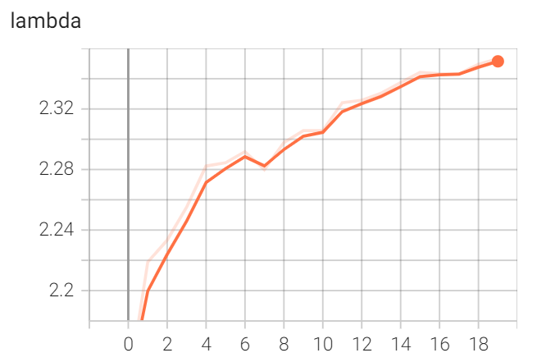
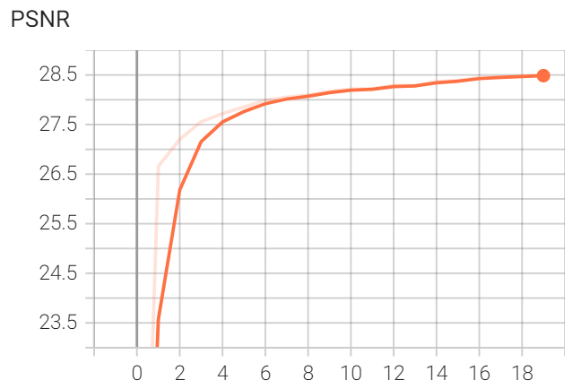
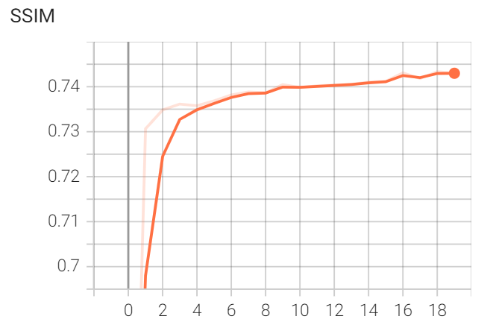
MoDL Training on FastMRI Dataset
n_layers: 5
k_iters: 10
epochs: 20

Slide 19
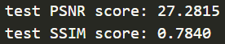
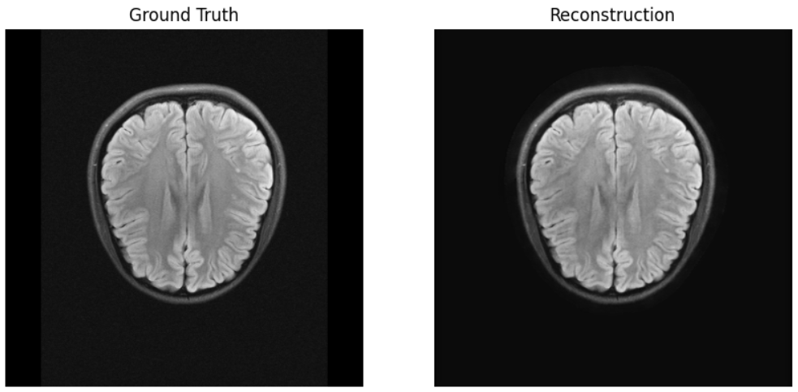
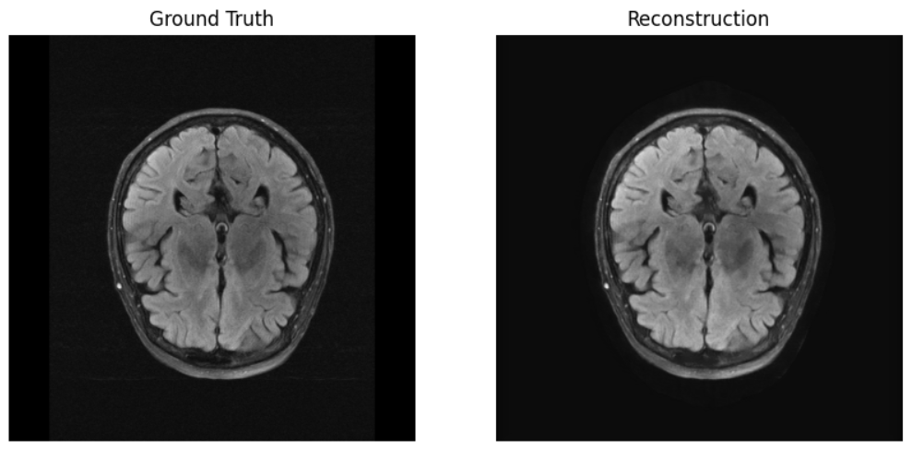

Slide 20
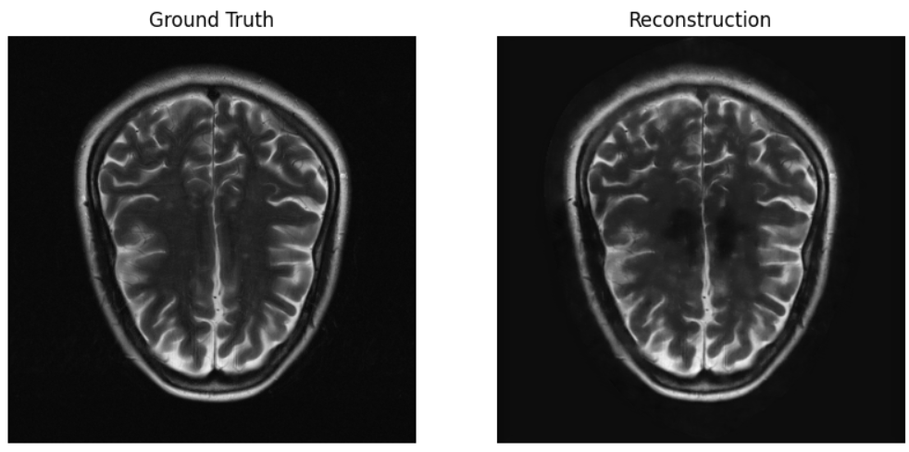
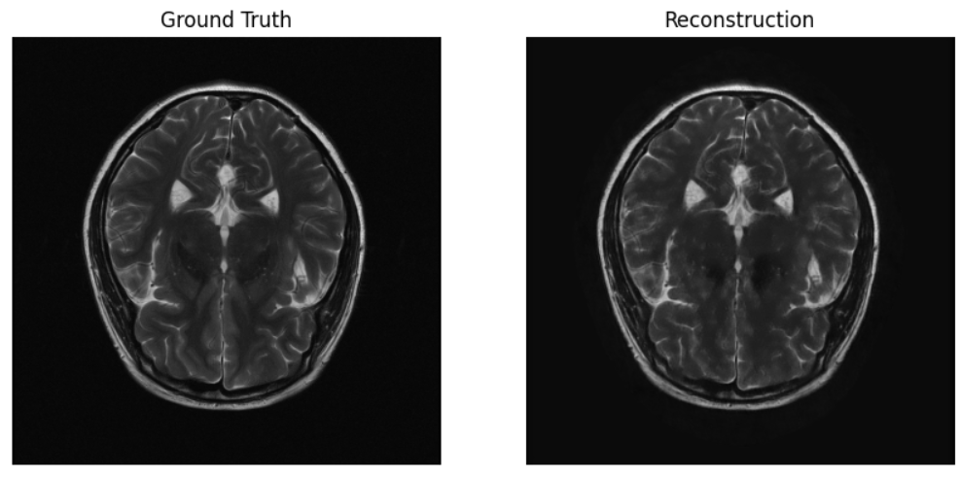

Slide 21
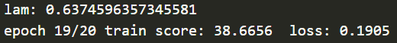
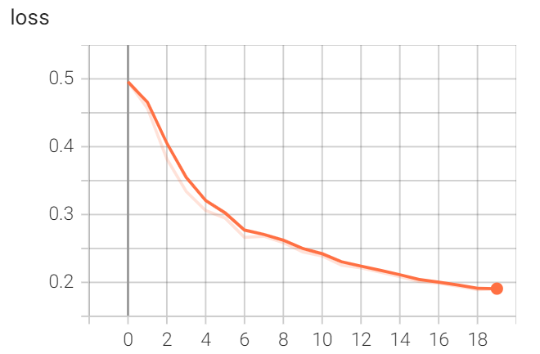
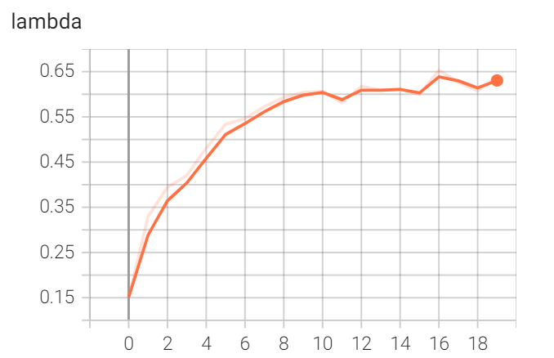
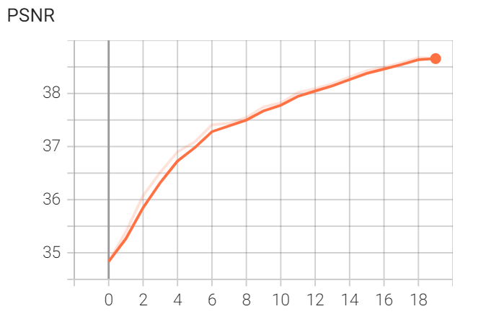
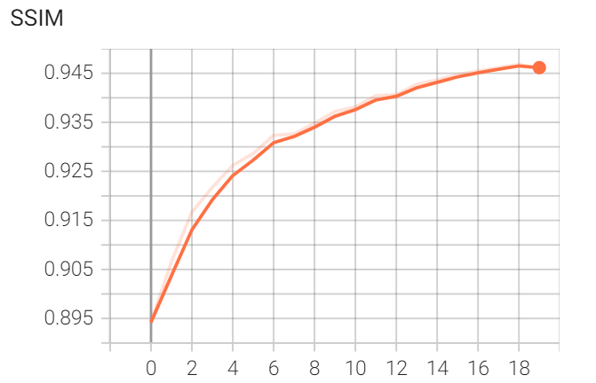
VarNet Training on FastMRI Dataset
n_layers: 5
k_iters: 10
epochs: 20

Slide 22
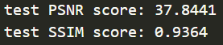



Slide 23



Slide 24





Effect of No. of Iterations, K
For MoDL

Slide 25
Effect of No. of Iterations, K
For MoDL
K = 10
K = 1
K = 1
K = 10

Slide 26


Effect of No. of Iterations, K
For VarNet

Slide 27


Effect of No. of Iterations, K
For VarNet
K = 1
K = 10
K = 1
K = 10

Slide 28






Effect of No. of Iterations, K
MoDL vs VarNet
MoDL, K=1
K=10
VarNet, K=1
K=10

Slide 29

Comparing Results from the Paper
In our experiments, PSNR decrease as the number of interations/unrolls of the model. Hence, there is an inconsistency between our experiments and the ones presented in the paper.
Professor suggested to investigate the matrix norms in data consistency implementation and keeping the lambda parameter constant.
Hemant K. Aggarwal. (2019) MoDL: Model-Based Deep Learning Architecture for Inverse Problems

Slide 30




Keeping Lambda Constant
n_layers: 5
k_iters: 10
epochs: 20

Slide 31
SSDU

Slide 32

Preparing the Dataset
Modifications, like cropping, done on kspace causes problems in the image space. Such modification should be performed in the image space to avoid dataset inconsistencies. Then convert the image space back to kspace using the inverse FFT.

Slide 33







Subsampling kspace

Slide 34



FastMRI Dataset for SSDU
SSDU works on kspace whereas MoDL/VarNet works on image space. The mask is split into two disjoint sets which are then used to get subsampled kspace set1 and set2 as explained in the next slide.
*mask in not shifted in the SSDU implementation

Slide 35
SSDU Learning Scheme
Burhaneddin Yaman. (2020) Self-supervised learning of physics-guided reconstruction neural networks without fully sampled reference data

Slide 36





Inside SSDU Training
kspace Set1 Θ Network Input
kspace Set2 Λ Used for loss calculation

Slide 37



SSDU Training
Default Learning Rate, lr=5e-4, k=10
Reduced Learning Rate, lr=5e-5, k=10
100 epochs
The loss curve does not converge when using the default learning rate.
SSDU is trained for 20 epochs to be comparable with MoDL/VarNet.

Slide 38




Effect of Number of Unrolls, K
k=1, lr=1e-5
k=10, lr=5e-5

Slide 39


Sample Inference
k=1
k=10

Slide 40

Back to MoDL Inconsistency in K
Effect of No. of Iterations, K (New Learning Rate)
K=1, default LR=0.001
K=10, default LR=0.001
K=10, new LR=0.01
Results are now consistent with the MoDL paper

Slide 41
MoDL vs VarNet vs SSDU
 | MoDL | VarNet | SSDU
VRAM | Medium | High | High
Effect of Unrolls on Score (k=1 vs k=10) | Minor Increase | Minor Increase | Minor Increase
PSNR | Better | Best | Good
SSIM | Better | Best | Good
Training Time | Good | Ok | Slow
Only undersampled kspace – Go for SSDU
Fully sampled kspace and hardware with high VRAM – Use VarNet
Fully sampled kspace but low VRAM hardware – Pick MoDL

Slide 42
Thank You

